Slide 1
Subham Laminates
Monthly Report
Dt: 1st March 2022 – 31st March 2022

Slide 2
Synopsys
Things carried out in the project.
Social media data representation.
GMB data representation.
Current bottlenecks in the project and possible resolutions
Next course of action.

Slide 3
Utility Chart
- March 1-31st 2022
Postings on Facebook on a regular basis, as well as keeping all of the content up to date.
March 2022
Up-to-date response management

Slide 4
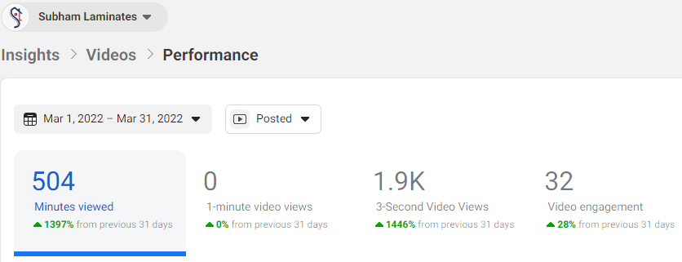

Slide 5
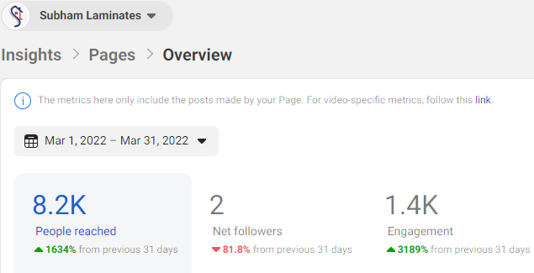

Slide 6
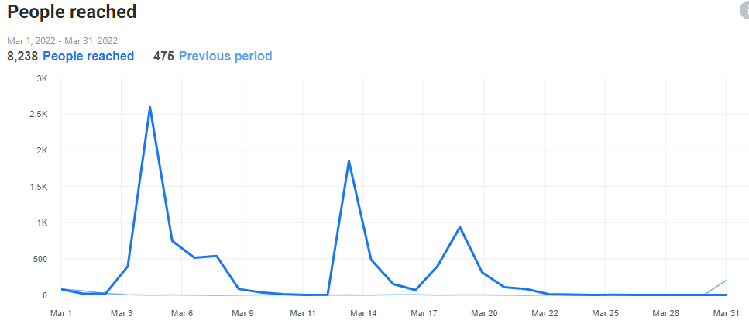
Total Reach

Slide 7
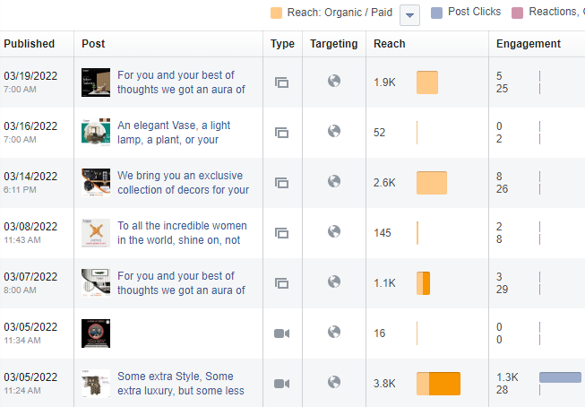

Slide 8
Numbers from Facebook
Post Insight
Reach - 9611
Impression - 10494
All Clicks - 1324
Page Engagement- 1325
Campaign Insight
Reach - 3168
Impression - 3286
All Clicks - 06
CTR- 0.18%

Slide 9
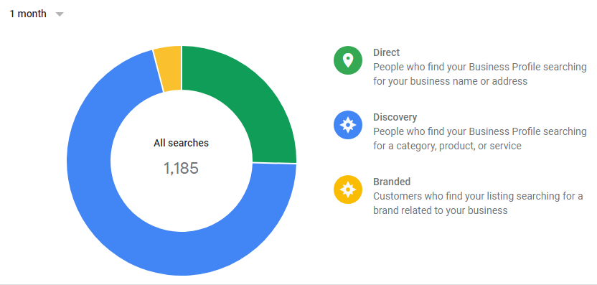
Numbers from Google My Business

Slide 10
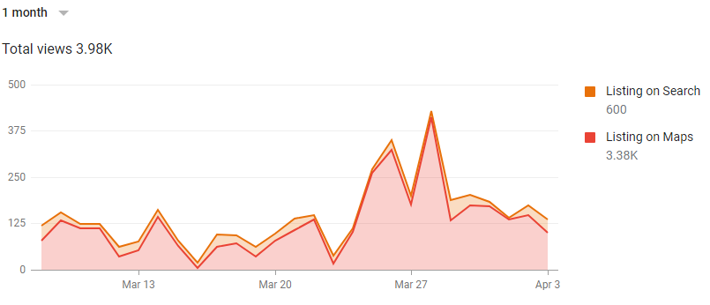
Total Views

Slide 11
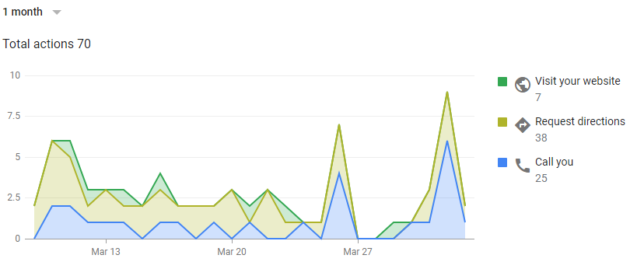
Customer Action

Slide 12
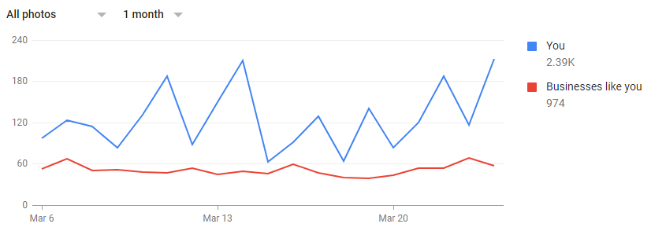
Photo Views

Slide 13
Findings
The impressions are being achieved at a decent numbers.
We are generating the views and impression but recall has not been established yet.
CTR is below average possibly because of no awareness and recall.
Click to conversion percentage is below average possibly because of lack of authority and trust.
The budget for media spend not established to test multiple campaigns.
All the data achieved organically.
The trend is positive in nature and needs to be optimised by continuous feedback mechanism.
It is more important start a post engagement and brand awareness campaign.
It is important to launch campaigns on all platforms, including social media and Google.

Slide 14
Bottlenecks
Lack of rich images
Low authority of the brand.
No media budget.
Production planning for new content
Customer feedback on GMB

Slide 15
Next course of action
We will gather the targeted audience.
The next step is to launch post engagement & brand awareness campaigns.
Increasing user engagement by posting real-time customer content and feedback..
Creating a window for daily/regular feedback validation with regards to the campaign dashboard.
Allocation of budgets and the launch of the campaigns.

Slide 16
Thank You

